Slide 1
Process Automation Techniques (SS21)
Open Proceedings - II
By:
Piyush Talele
Ali Asghar Marvi

Slide 2
Background
Automation describes a wide range of technologies that reduces human intervention in processes.
For this presentation we will focus on IT automation, mainly in domain of DevOps.
Automation in conventional setting was/is done using Task Scheduler/Cron job.
The goal of IT automation is to replaces IT Professional’s manual work.

Slide 3
Introduction
Some of the example use cases include:
Chatbots
Sending computer generated emails
Auto- reading emails
Automatic logging
...
Evolvement of technology paved way for automation.
Robotic Process Automation - a buzz word for screen scraping tasks and a lot more!
Its fast, flexible, scalable and reliable.
AI driven use cases to handle RPA in deployment.

Slide 4
Industrial Tools
Ui-Path - Premium Tool:
Provides sets of tools:
Orchestrator
Automation Hub
Process mining
...
Automation Anywhere - Premium Tool not available to test it
KNIME:
Workflow Abstraction Techniques.
ETL jobs
KNIME Server Version Management
…
Selenium - Open Source

Slide 5
Gitlab
Enhanced capabilities for DevOps based automation tasks such as:
CI/CD (Continuous Integration/Continuous Deployment) - Handle integration and deployment in production.
Continuous Testing - initiate resolution for test cases right after push!
Concurrent DevOps - handle deployment on multiple distributed environment.
AI and Machine Learning - Continuous Machine Learning (CML) tool for model deployment, re-training, visualization, etc .
New Environment for us …
Premium functionalities of CI/CD:
Pipeline execution and status
Creating Jobs
Editor for .yml
Scheduler
Packages & Registries
...
Notes:
Familiarizing with environment:
We explored through menus - configured git runners on local instance - adding in ssh at client end - created test repository - a test pipeline too with make file
-Gitlab was new to us all especially considering its premium features regarding CI/CD. Never though Gitlab has so much more to offer. Gitlab settings.
- dockers and .yml file. Separate Container Registry
-Creating deployment environments
-Pipeline history
- artifacts downloads
- output of one pipeline to other (.yml configuration)

Slide 6
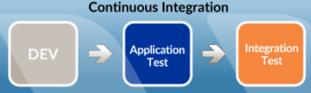
CI/CD
CI/CD was new for us. The entire concept itself.
Started with configuring Gitlab Runner instance on our local machines:
Configuring ssh keys.
Creating a local Gitlab instance itself.
Three types of runners:
Shared Runners - are for use by all projects
Group Runners - are for all projects and subgroups in a group
Specific Runners - are for individual projects
.yml file: gitlab-ci.yml file is heart of all steps defined to execute our individual jobs in a pipeline.
Defining stages in .yml file for each job.
Easier to point to respective docker images in container registry.
Sub-attribute “untracked: true” flag in artifact attribute to point the output of one job to another, until the end.
Image Ref: Details

Slide 7
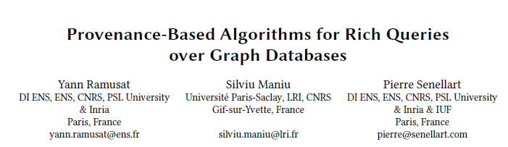
Our Task
Open Proceedings II - create a CI/CD pipeline to parse research papers by adding in details:
“Bulk Processing” of a complete Proceedings Volume
Sanity checks
Adding page numbers
Generate Table of Contents (ToC)
Create HTML representation with downloadable links
Adding extra material such as pitch, posters, videos.
Various Corrections regarding metadata were in scope too but we tackled that using warnings to not interrupt the execution process.
These papers had to adhere Google Scholars standards for indexing regarding size (5 MB) and A4 page layout.
All papers followed a pattern in terms of layout, in terms of title, author names, institution.

Slide 8
Approaches
Started with scripting - three stages (first demo):
Sanity checks of our pdfs:
Used node script JS and relevant meta-data from edbt.xml file.
Created edbt.json as our temp file for further execution.
We tried it in python first, but parsing in string format was breaking execution at “&” sign.
Adding page numbers:
Numbered our pdf files.
This task was done in Python using set of dependencies.
Output was written in a temp directory
Creating ToC:
ToC was added in a temp static HTML file.
Merging it with PDFs created in last step.
These executions were handled using “Makefile” script.
Next we replicated these stages as three jobs in a pipeline.
This is where we learned how jobs can be created in gitlab instance using .yml file.

Slide 9
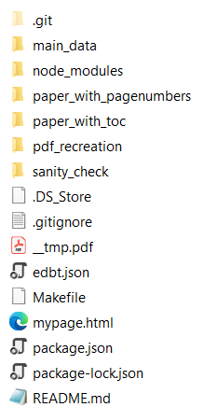
Approaches
Next step was our first ever attempt for creating dockerized images in Gitlab.
Most of our time went by trying to figure out how to access individual files in temp directories.
File order in our directory became an issue. We did not know how to access relevant sub-directories which were outside the scope of Docker file.
This is where use of container registry came in.
We first tried to create one docker image with both node and python dependencies in one.
Dependencies began to conflict with each other. Next real challenge in our project.
We decided to split in two separate docker images. It worked! But…
Due to OS and version specific dependencies in Python, merging ToC in PDFs became a problem.
This is where we splitted stage 2 and stage 3 such that page numbering and ToC generation was done in stage 2.
Merging process of ToC to PDFs was handled in stage 3 with another Docker image.

Slide 10
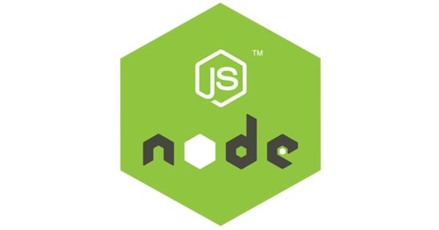
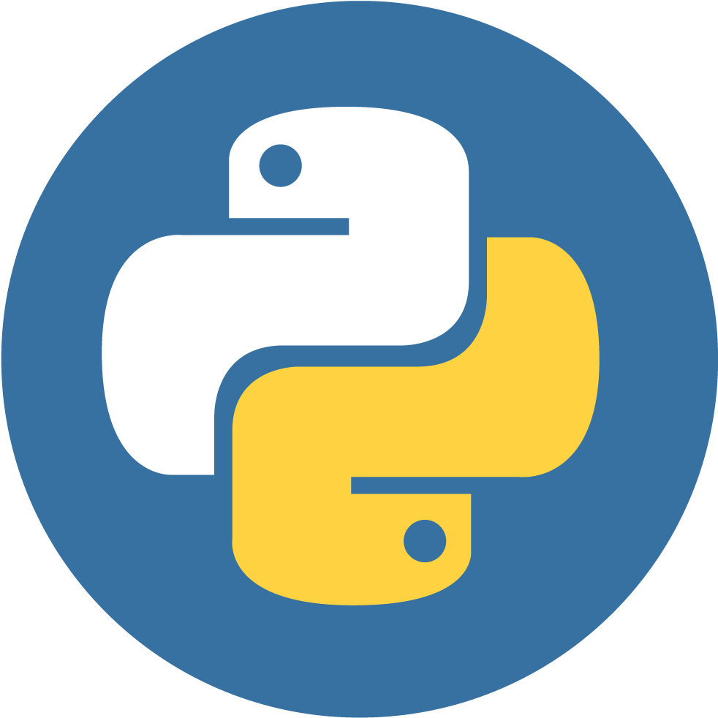
NodeJs & Python based
Main reason was the previous experience in pdf handling using python.
Many libraries for pdf manipulation emerged within last few years.
NodeJS allows to use naive methods with easy and short code syntaxes.
JSON/XML parsing and traversing is very easy in nodeJS (used for sanity checks).
Python is a backend language, have a scope to convert the whole pipeline into a REST API for further interventions targeted for various applications.
Methods used for PDF manipulation in python have various options with styling options, layer position options.
Use of robust & most common technology.
Image Ref: Python & NodeJS

Slide 11
Dockerization
Our scripts were diverse in technologies (js and python).
We needed a common environment containing already installed libraries and necessary binaries.
Container registry concept also needed docker files.
Docker image can be either a whole OS or a specific technology image.
Also YAML was to use as main file containing stages so uncleared concept issue of how to combine both docker image and YAML file was the question of that month !
Creating an Environment

Slide 12
Gitlab Container Registry
With the Docker Container Registry, GitLab project gets its own space to store its Docker images.
Which can be used in YAML files (for our project).
The docker image from container registry can be build and run locally by using.
The url of image follows a specific naming convention.
<registry URL>/<namespace>/<project>/<image>
Docker image needs to be build locally and then can push to container registry using unique gitlab project url.
Docker-in-Docker image scripting can be done by building docker image from container registry in YAML file.
Concept of one docker image with all required dependencies.

Slide 13
Docker Image Challenges & Solution
Library Image or OS image ?
Docker Image 1 was node, couldn’t execute OS level binaries used in further python files.
Docker Image 2 was python because need a lot file management in buffer (untracked files).
Docker Image 3 was OS, needed for wkhtmltopdf binaries needs to be installed in OS (debian buster), library image cannot be used.
Choice of creating three Dockers

Slide 14
Scripts Overview
Code Architecture & Demo
# | Pipeline Stage (from YAML file) | Image Used (From container registry) | Script & Executor | External Libraries Used | Artifacts Generated
1 | build-sanity-check | Image 1 (Node Image) | sanity_check_formats.js (NodeJS) | pdf2json, xml2json | ebdt.json
2 | build-page-toc | Image 2 (Python Image) | add_page_numbers.py (Python) | reportlab, pypdf2 | Pdf with page numbers (.pdf)
3 | build-page-toc | Image 2 (Python Image) | pdf_toc.py (Python) | reportlab, pypdf2, pdfkit, fitz | Pdf with TOC (.pdf)
4 | build-add-final-toc | Image 3 (Debian OS, Python & wkhtmltopdf) | Add_toc_final.py (Python) | pypdf2, pdfkit | Materials with listing HTML page.

Slide 15
Our Output
Artifacts, that have been created throughout the pipelines.
Final PDFs, Pitch and Posters along with listing HTML page.
DBLP & DOI-TO-URI publishing material, but without specified XML index & metadata files.
Time taken by pipeline to execute.

Slide 16



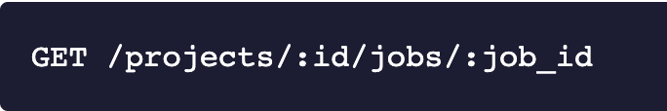

Further Pipeline Automations
Using Gitlab official APIs angular or any JS website can be built.
-> More that could have been done for end to end automation.
-> Concept would be upload edbt.xml file and the pipeline will be triggered.
-> All real-time stats will be shown on the website.
-> Many modifications can be done for various application purposes..
API Ref: https://docs.gitlab.com/ee/api/api_resources.html

Slide 17

Further Server Automations
Our Angular or JS app can further be automated using Ansible Software.
Ansible is open-source application-deployment tool enabling infrastructure as code (IaC).
Ansible using YAML files can be used as image for docker file.
Deployment & Updation of angular or JS application will be automated.
“CD” of “CI/CD” could be possible with this, due to continuous app deployment in production, also because of edbt.xml file upload dynamically.
Image Ref: Ansible

Slide 18

Thank You
Any Questions?

